Slide 1
HOW TO WRITE THE GOOD CODE
_

Slide 2
AGENDA
What your code should do
Three simple programming principles
One not very simple principle

Slide 3
WHAT SHOULD YOUR CODE DO?

Slide 4
WORK!

Slide 5
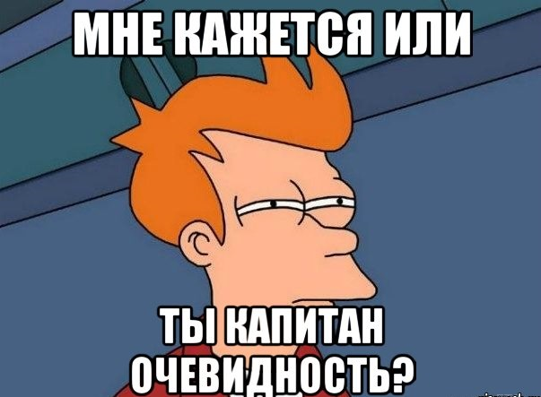

Slide 6
Feet requirements
WORK =
Cover edge cases

Slide 7
If you do something known – do it good
If you do something new – make it work

Slide 8
Not only happy case

Slide 9
HANDLE EXCEPTIONS!
public class VirtualApi
{
public string Do(int x)
{
using (WebClient xx = new WebClient())
{
return xx.DownloadString("https://bash.im");
}
}
}

Slide 10
public string Do(int x)
{
using (WebClient xx = new WebClient())
{
try
{
return xx.DownloadString("https://some.super.url");
}
catch (Exception e)
{
Log(e);
}
return "";
}
}

Slide 11
All third party inputs should be treated as invalid and dangerous

Slide 12
Easy to read
Be maintainable
Easy to change

Slide 13
const getRanges = arr => arr
.reduceRight((r, e) => r.length ?
(r[0][0] === e + 1 ? r[0].unshift(e) : r.unshift([e])) && r : [[e]], [])
.map(a => a.join('-')).join(',')
Writing the code keep in mind that it will be supported by absolutely crazy man with big axe who knows where you live

Slide 14
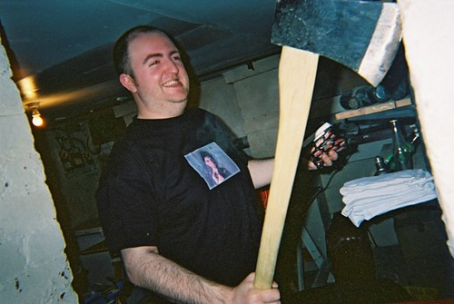

Slide 15
NAMING
public string Do(int x)
{
using (WebClient xx = new WebClient())
{
try
{
return xx.DownloadString("https://some.super.url");
}
catch (Exception e)
{
Log(e);
}
return "";
}
}

Slide 16
NAMING
public string Do(int x)
{
using (WebClient xx = new WebClient())
{
try
{
return xx.DownloadString("https://some.super.url");
}
catch (Exception e)
{
Log(e);
}
return "";
}
}

Slide 17
«There are only two hard things in Computer Science: cache invalidation and naming things.»
(C) Phil Karlton

Slide 18
public string GetUserName(int userId)
{
using (var http = new WebClient())
{
try
{
return http.DownloadString(Api.GetUserNameUrl);
}
catch (Exception e)
{
_logger.Log(e);
}
return string.Empty;
}
}

Slide 19
Low coupling
High cohesion

Slide 20
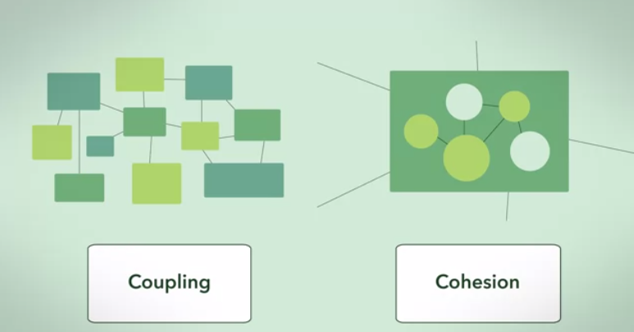

Slide 21
Big ball of mud != Easy to change

Slide 22
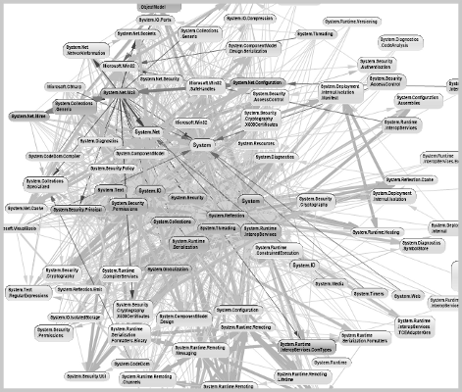

Slide 23
Keep the same code style

Slide 24
Be performant
enough

Slide 25
public string GetUserName(int userId)
{
using (var http = new WebClient())
{
try
{
return http.DownloadString(Api.GetUserNameUrl);
}
catch (Exception e)
{
_logger.Log(e);
}
return string.Empty;
}
}

Slide 26
public async Task<string> GetUserName()
{
using (var request = new HttpClient())
{
try
{
return await request.GetStringAsync(userUrl);
}
catch (Exception)
{
Log(e);
}
}
return string.Empty;
}

Slide 27
Be tested with reasonable coverage

Slide 28
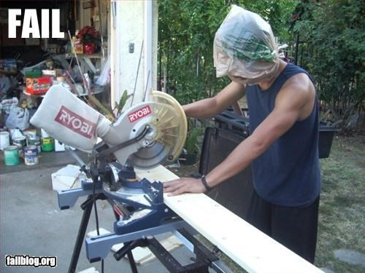
When code
coverage = 100%

Slide 29
Simple principles to
make your life easier

Slide 30

Keep
It
Simple
Stupid
Design principle noted by the U.S. Navy in 1960

Slide 31
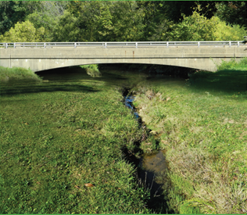
You
Aren’t
Gonna
Need
It
Extreme programming principle

Slide 32
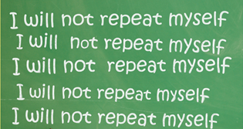
Don’t
Repeat
Yourself

Slide 33
S.O.L.I.D

Slide 35
Single-responsibility Principle

Slide 36
Open-closed Principle

Slide 37
Liskov substitution principle

Slide 38
Interface segregation principle

Slide 39
Dependency Inversion principle

Slide 40
THANKS FOR LISTENING

